Slide 1

Evaluating Factors Influencing PISA Test Reading Scores
Hriddhi Doley
Oct-2024

Slide 2

Problem Statement
The PISA (Program for International Student Assessment) dataset provides insight into the educational performance of 15-year-olds worldwide. This project aims to analyze various factors influencing students' reading scores. We will identify significant predictors of reading performance by evaluating demographics, parental education, school characteristics, and student behavior. The findings can help educators and policymakers understand how to improve student outcomes.
Dataset: PISA

Slide 3
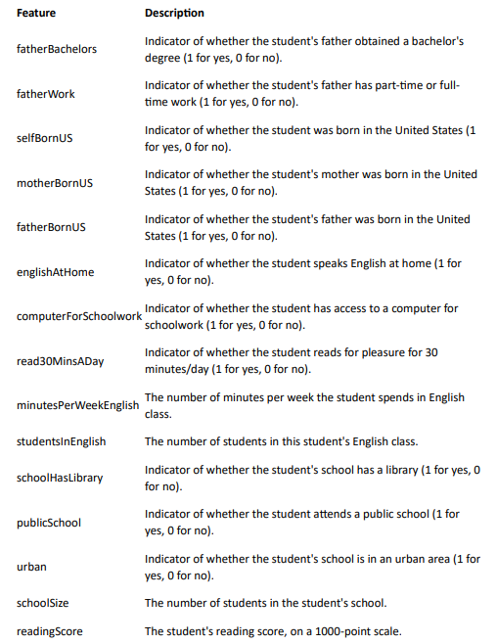
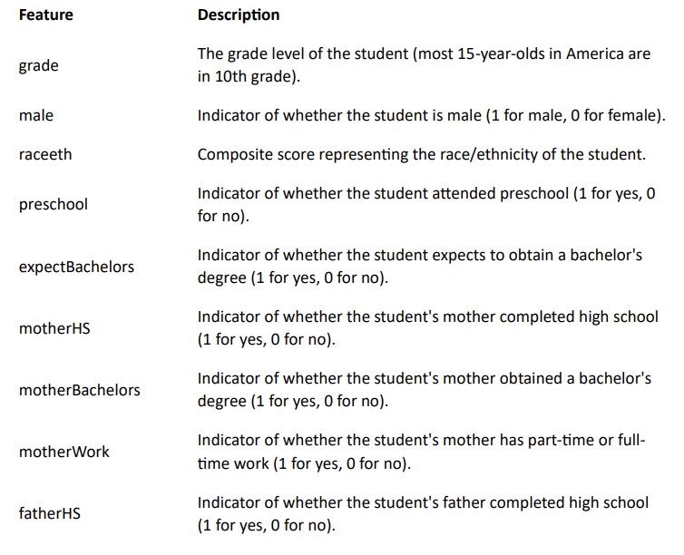
Dataset overview
The dataset includes multiple features related to students' backgrounds and their performance in reading assessments. Below are the key variables in the dataset:

Slide 4
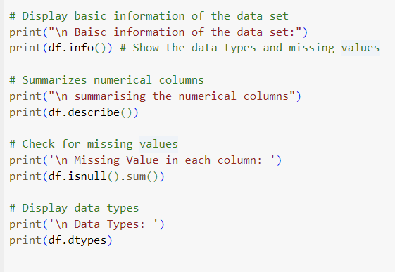
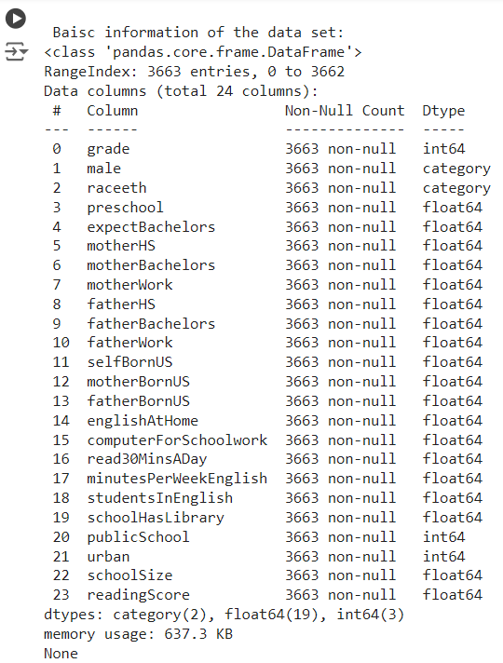
Data inspection
Data types of the columns and the missing values were checked using the pandas python libraries. Below are the observations:
The dataset contains 3663 entries and 24 columns.
Most columns are of type float64, with 'grade' and 'male' being int64, and 'raceeth' being object (likely categorical).
There are missing values in several columns, with 'fatherBachelors' having the most (569 missing values).

Slide 5
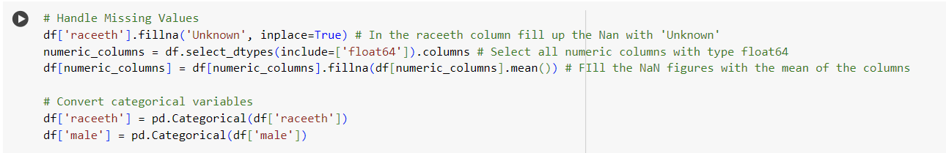
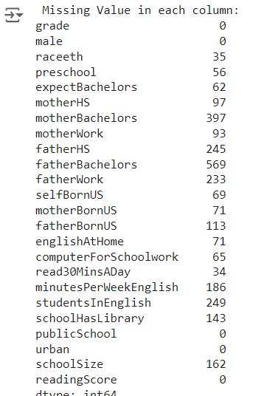
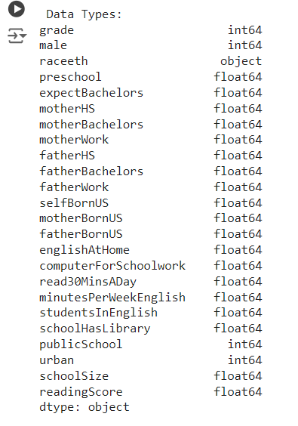
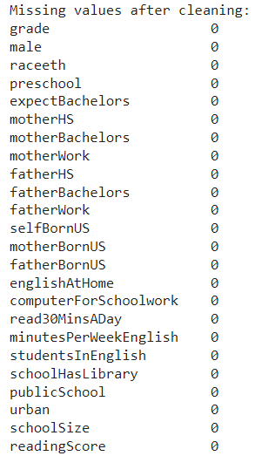
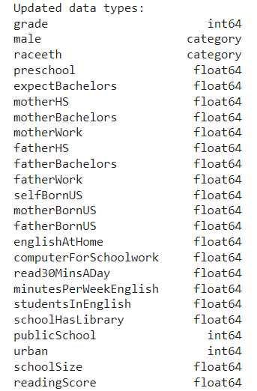
Handling Missing Values
The following steps were followed
Fill up the missing values in the 'raceeth' column with 'Unknown’
In numeric columns with their mean
Convert specified columns to categorical data types
Verify the changes by printing missing values, data types, and summary statistics.
Before Cleaning
After Cleaning

Slide 6

Data Visualization
The following three data visualizations were used to analyze the data
Box Plot of Reading Scores by Race/Ethnicity:
This plot shows the distribution of reading scores across different racial/ethnic groups.
2. Scatter Plot of Reading Scores vs. Minutes per Week Spent on English:
This plot illustrates the relationship between time spent on English and reading scores.
3. Box Plot of Reading Scores by Gender:
This plot compares reading scores between genders.
Key insights include:
The mean reading score is approximately 498.
Asian students have the highest mean reading score, while American Indian/Alaska Native students have the lowest.
There is a weak positive correlation (0.064) between minutes spent on English and reading scores.
Female students have a higher mean reading score compared to male students.

Slide 7
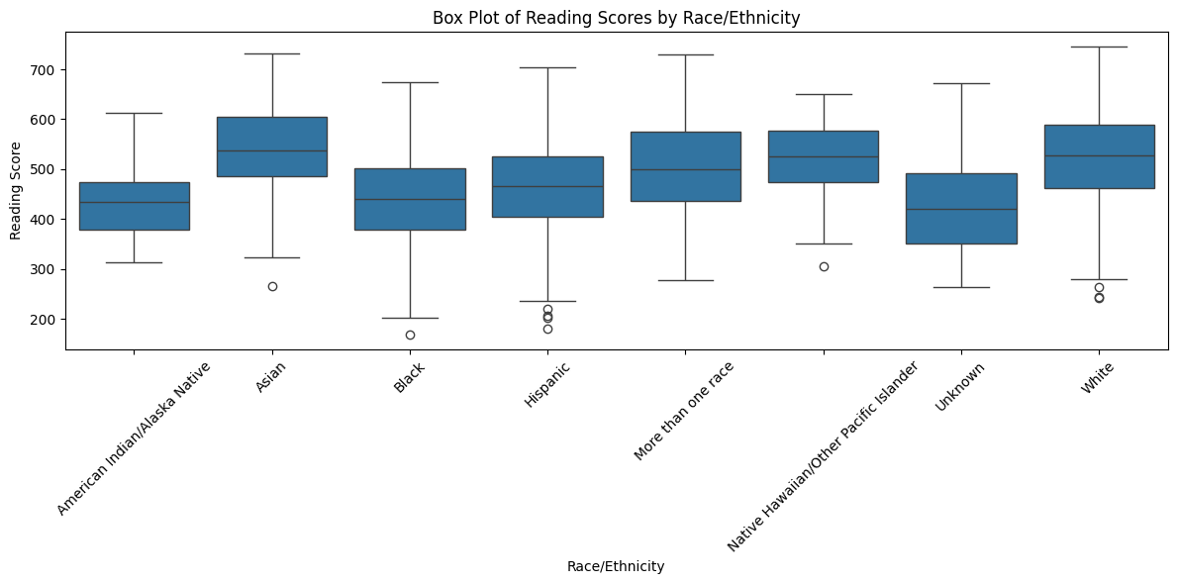
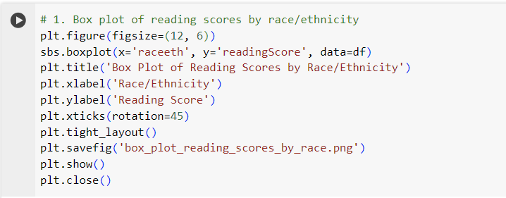
Data Visualization: Box Plot of Reading Scores by Race/Ethnicity
Distribution of Scores:
The box plot shows the distribution of reading scores for different racial/ethnic groups.
Each box represents the interquartile range (IQR) for that group, with the median shown as a line within the box.
Median Scores:
Asian students appear to have the highest median reading score, followed by White students.
Hispanic and Black students have lower median scores compared to Asian and White students.
Score Ranges:
There is considerable overlap in the score ranges across all groups, indicating that while there are differences in average performance, there is also significant variation within each group.
Asian students show the largest range of scores, suggesting high variability in performance within this group.
Outliers:
All groups have outliers, represented by individual points beyond the whiskers.
There are more low outliers than high outliers across all groups, indicating some students in each category who significantly underperform compared to their peers.
Performance Gaps:
There appears to be a noticeable gap in performance between Asian/White students and Hispanic/Black students.
This gap suggests potential disparities in educational outcomes that may need to be addressed.
Variability:
The size of the boxes (IQR) varies between groups, with some showing more consistency in scores (smaller boxes) and others showing more variability (larger boxes).
Skewness:
Some distributions appear slightly skewed, as indicated by the position of the median line within the box.
Insights: These insights highlight performance differences among racial/ethnic groups in reading scores. While these differences exist, many factors beyond race/ethnicity can influence academic performance, such as socioeconomic status, school quality, and individual circumstances. This data could be used to inform targeted interventions and support programs to help close achievement gaps and ensure equitable educational outcomes for all students.

Slide 8
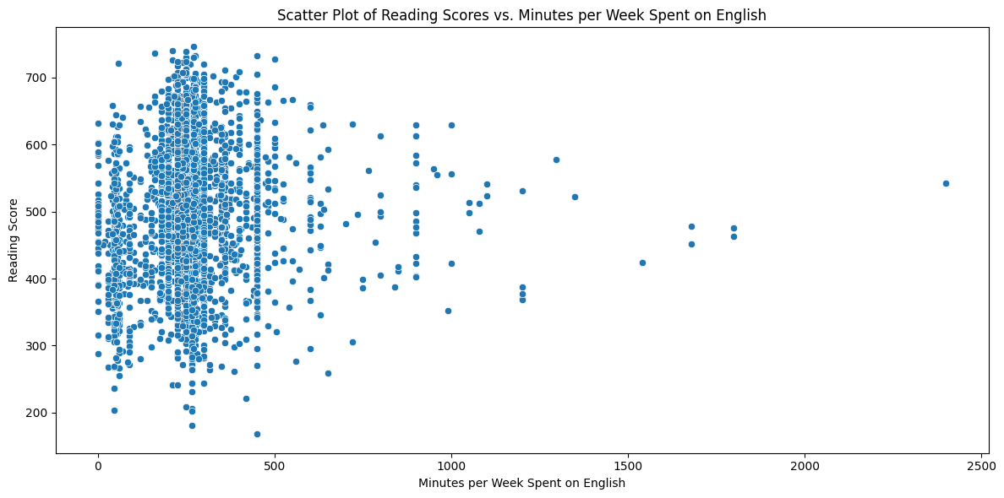
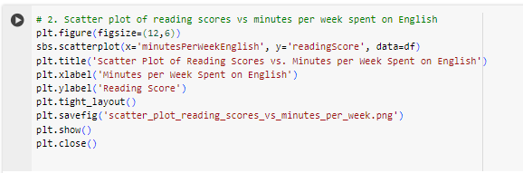
Data Visualization: Scatter Plot of Reading Scores vs. Mins/ Week Spent on English
Overall Relationship: The scatter plot shows how reading scores relate to the time students spend on English each week. The correlation coefficient is about 0.0678, which means there's a very weak positive relationship between these two factors. In simple terms, spending more time on English doesn't necessarily lead to much higher reading scores.
Spread of Data: The dots on the graph are quite spread out, forming a cloud-like shape. This scatter suggests that while some students who spend more time on English do have higher scores, many others don't. It's not a clear-cut "more time = better scores" situation.
Time Spent on English:
On average, students spend about 266 minutes (roughly 4.5 hours) per week on English.
The least amount of time spent is 0 minutes, while the most is 2400 minutes (40 hours) per week.
Half of the students spend between 225 and 300 minutes (3.75 to 5 hours) per week on English.
Reading Scores:
The average reading score is about 498 out of 746.
Scores range from as low as 169 to as high as 746.
Half of the students score between 432 and 566.
Interesting Points:
There are some students who spend very little time on English but still achieve high scores.
Conversely, some students spend a lot of time but don't necessarily score higher.
Most students cluster around the middle range for both time spent and scores achieved.
Considerations:
The data doesn't tell us about the quality of the time spent or the specific activities done during English study.
Individual differences, like learning speed or prior knowledge, aren't captured in this simple relationship.
Insights: In conclusion, while there's a slight tendency for more time spent on English to relate to higher reading scores, it's a very weak connection. This suggests that other factors beyond just time spent are important in determining reading performance. For students and educators, this means focusing on effective study strategies might be more beneficial than simply increasing study time.

Slide 9
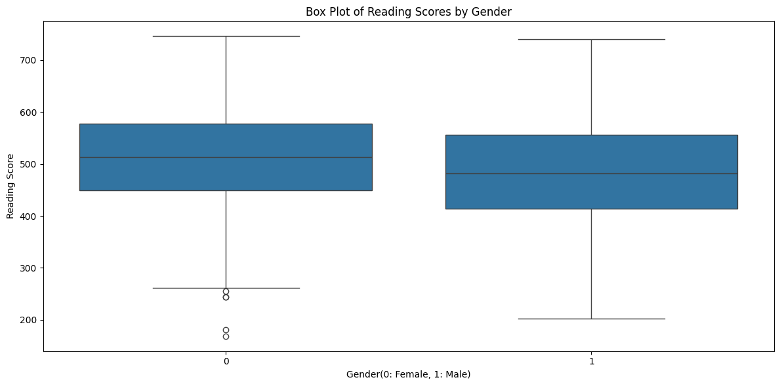
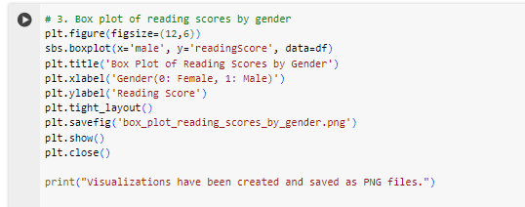
Data Visualization: Box Plot of Reading Scores by Gender
The box plot shows the distribution of reading scores for male and female students. Let's break down the insights:
Median Scores:
Female students generally have a higher median reading score compared to male students. The median is the middle value, so this suggests that, on average, females tend to score higher in reading.
Score Range:
Both genders have a similar range of scores, but the spread (or variability) of scores is slightly wider for males. This means that while some male students score very high, others score quite low, leading to more variability.
Interquartile Range (IQR):
The IQR, which is the range between the 25th and 75th percentiles, is slightly larger for males. This indicates more variation in the middle 50% of male scores compared to females.
Outliers:
Both genders have outliers, which are scores that are significantly higher or lower than the rest. These are represented by individual points outside the whiskers of the box plot.
Overall Performance:
The plot suggests that female students generally perform better in reading than male students, as indicated by the higher median and slightly more compact score distribution.
In summary, the box plot indicates that female students tend to have higher reading scores on average, with less variability compared to male students. This suggests that gender may play a role in reading performance, with females generally outperforming males in this dataset.

Slide 10
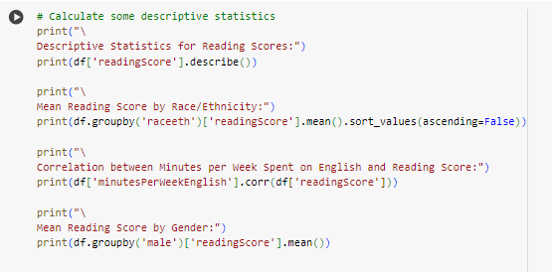
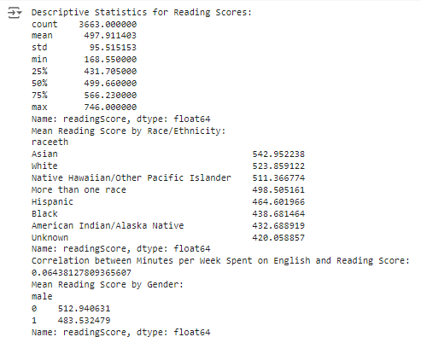
Descriptive Statistics - Insights
The below insights highlight differences in reading performance based on gender and race/ethnicity, while also showing that time spent on English has a minimal impact on reading scores.
Descriptive Statistics for Reading Scores:
The average reading score is about 498.
Scores range from a low of about 169 to a high of 746.
Most students score between 432 and 566, with the middle score (median) being around 500.
Mean Reading Score by Race/Ethnicity:
Asian students have the highest average reading score, followed by White students.
American Indian/Alaska Native and Black students have the lowest average scores.
This suggests some differences in reading performance across different racial/ethnic groups.
3. Correlation between Minutes per Week Spent on English and Reading Score:
The correlation is about 0.068, which is very weak.
This means that spending more time on English doesn't strongly relate to higher reading scores.
4. Mean Reading Score by Gender:
Female students (coded as 0) have a higher average reading score (about 513) compared to male students (coded as 1) who have an average score of about 484.
This indicates that, on average, female students perform better in reading than male students.

Slide 11
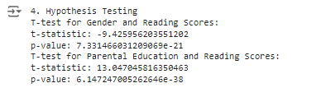
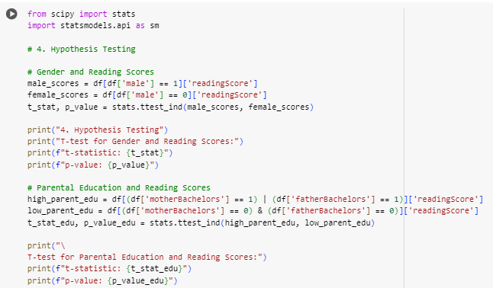
Hypothesis Testing
Gender and Reading Scores:
The t-test for gender shows a significant difference in reading scores between males and females with a t-statistic of -9.43 and a p-value of 7.33×10−21, indicating that gender has a significant impact on reading scores. A highly negative t-statistic suggests that the average reading scores for males are significantly lower than the females. The p-value is extremely small, meaning this difference is statistically significant, so it's highly unlikely this result is due to chance.
Parental Education and Reading Scores:
The t-test for parental education shows a significant difference in reading scores between students with at least one parent having a bachelor's degree and those without, with a t-statistic of 13.05 and a p-value of 6.15×10−38. The positive t-statistic suggests that there is a strong association between higher parental education levels and better reading scores. The extremely small p-value again means this result is statistically significant, implying that it's very unlikely this association is due to random variation.

Slide 12
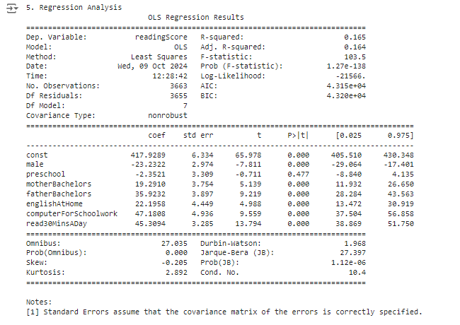
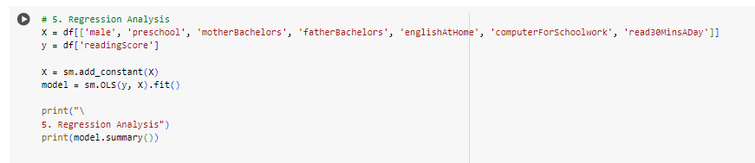
Regression Analysis
1. The regression model identifies significant predictors of reading scores, including gender, parental education, English spoken at home, computer use for schoolwork, and reading for 30 minutes a day.
2. R-squared (0.165): This tells us that the independent variables (factors) explain about 16.5% of the variation in reading scores. This isn't very high, suggesting many other factors influence reading scores not included in this model.
3. Adj. R-squared (0.164): Adjusted for the number of predictors, this value is close to the R-squared value, indicating the model is not overfitting.
4. Gender has a significant negative impact on reading scores, with boys scoring lower than girls.
5. Parental education (both mother’s and father’s bachelor’s degrees) has a strong positive impact on reading scores.
6. Speaking English at home, using a computer for schoolwork, and reading for 30 minutes a day are all associated with higher reading scores.
7. Attending preschool does not have a statistically significant impact on reading scores, at least in this model.
8. Some factors, like gender, parental education, and certain habits (computer use and reading), play a significant role in reading performance.
9. The overall model explains about 16.5% of the variation in reading scores, meaning that other factors not included in the analysis also influence reading performance.

Slide 13
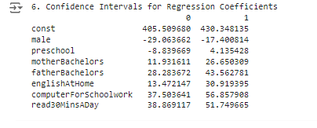

Confidence Interval
Confidence intervals for the regression coefficients provide a range of values within which the true coefficient is likely to fall, indicating the reliability of the estimates.
The intervals tell us how much each factor affects reading scores with 95% confidence. If the interval is far from zero, like for Male, Father’s Education, Computer Use, and Daily Reading, we can be fairly confident these factors have a significant effect on reading scores. For Preschool, the confidence interval includes both negative and positive values, meaning the effect is uncertain.

Slide 14
Conclusion
Implications for Educational Practices and Policies
Gender Differences: The significant impact of gender on reading scores suggests the need for targeted interventions to support male students in improving their reading skills.
Parental Education: The influence of parental education highlights the importance of parental involvement and support in a child's education. Programs that engage parents and provide resources for educational support could be beneficial.
Predictors of Success: Factors such as English spoken at home, computer use for schoolwork, and regular reading habits are significant predictors of reading success. Educational policies should encourage these practices to enhance student performance.
These findings can guide educators and policymakers in developing strategies to improve reading outcomes for students.

